Slide 1
Java Standard Tag Library (JSTL) various scopes, Database connectivity

Slide 2
JSTL Core Tag List
Tags | Description
c:out | It display the result of an expression
c:set | It sets the result of an expression under evaluation in a 'scope' variable.
c:remove | It is used for removing the specified variable from a particular scope.
c:if | It is conditional tag used for testing the condition and display the body content only if the expression evaluates is true.
c:choose, c:when, c:otherwise | It is the simple conditional tag that includes its body content if the evaluated condition is true.
c:forEach | It is the basic iteration tag. It repeats the nested body content for fixed number of times or over collection.
c:param | It adds a parameter in a containing 'import' tag's URL.
c:redirect | It redirects the browser to a new URL and supports the context-relative URLs.

Slide 3
JSTL Core <c:out> Tag
<c:out>
It will display the result of an expression
Example
Index.jsp
<%@ taglib uri="http://java.sun.com/jsp/jstl/core" prefix="c" %>
<html>
<head>
<title>Tag Example</title>
</head>
<body>
<c:out value="${'Welcome to javaTpoint'}"/>
</body>
</html>

Slide 4
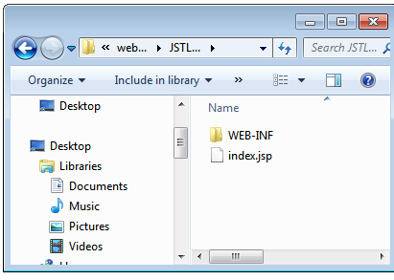
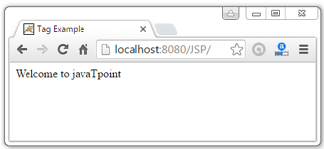
How to run JSP program if it has JSTL tags?
Copy the files jstl.jar and standard.jar in WEB-INF/lib
Create a new folder JSTLTags and copy WEB-INF and the index.jsp
Navigate to http://localhost:8080/JSTLTags

Slide 5
JSTL Core <c:set> Tag
<c:set>
Used to set the result of an expression evaluated in a 'scope‘
<c:set> tag is helpful because it evaluates the expression
Example
<%@ taglib uri="http://java.sun.com/jsp/jstl/core" prefix="c" %>
<html>
<head>
<title>Core Tag Example</title>
</head>
<body>
<c:set var="Income" scope="session" value="${4000*4}"/>
<c:out value="${Income}"/>
</body>
</html>
Output: 16000

Slide 6
JSP Scopes
Scope of a variable
Decides the accessibility of an object or variable
For example, some variables are accessible within for loop, if-else block or within specific method or class or package
JSP provides 4 scopes to a variable.
Developer can assign any one of them to a variable
Page Scope
Request Scope
Session Scope
Application Scope

Slide 7
Page Scope
Page Scope makes variable available to the developer for the current page only
Variable will not be available in next page
When current page is closed by user
Forwarded internally by application
Redirected by application

Slide 8
Page Scope - Example
<%@ taglib uri="http://java.sun.com/jsp/jstl/core" prefix="c" %>
<html>
<head>
<title>JSP Page Scope Example</title>
</head>
<body>
<c:set var="name" value="Dinesh" scope="page" />
Local Variable : <c:out value="${name}" />
<a href="test.jsp">Test Page</a> </body> </html>
Output : Local Variable: Dinesh
Test Page

Slide 9
Page Scope - Example
test.jsp
<%@ taglib uri="http://java.sun.com/jsp/jstl/core" prefix="c" %>
<html>
<head>
<title>JSP Page Scope Example</title>
</head>
<body> Variable From previous page : <c:out value="${name}" />
</body>
</html>
Output: Variable from previous page:

Slide 10
Page Scope - Example
Created 2 JSPs
On First JSP, local variable 'name‘ has been created using JSTL Core tag c:set.
This variable has a value 'Dinesh' and assigned 'Page' scope using scope attribute of c:set tag.
Provided a link on the same JSP that points to another JSP.
When first JSP is executed, it prints the variable name successfully and also provided link on the browser
On Second JSP, tried to print the same variable from the first page
It did not print the variable value defined in first JSP
This example result of 2 JSPs confirms that, if a variable has Page Scope, it is accessible in only that page and not on any other page.

Slide 11
Request Scope
Request Scope makes variable available to the developer for the current request only
Once the current request is over, then the variables having request scope will not be accessible on next request
Single request may include multiple pages using forward

Slide 12
Request Scope Example
<%@ taglib uri="http://java.sun.com/jsp/jstl/core" prefix="c" %>
<html>
<head>
<title>JSP Request Scope Example</title>
</head>
<body>
<c:set var="name" value="Dinesh" scope=“request" />
Local Variable : <c:out value="${name}" />
<jsp:forward page="test.jsp">Test Page</a> </body> </html>
Output : Local Variable: Dinesh
Test Page

Slide 13
Request Scope Example
test.jsp
<%@ taglib uri="http://java.sun.com/jsp/jstl/core" prefix="c" %>
<html>
<head>
<title>JSP Request Scope Example</title>
</head>
<body> Variable From previous page : <c:out value="${name}" />
</body>
</html>
Output: Variable from previous page: Dinesh
This example result of 2 JSPs confirms that, if a variable has Request Scope, it is accessible in current request and on any page as long as request remains same

Slide 14
Session Scope
Session Scope makes variable available to the developer for the current session only
Once the current session is over or timed out, then the variables having session scope will not be accessible on next session

Slide 15
Session Scope Example
<%@ taglib uri="http://java.sun.com/jsp/jstl/core" prefix="c" %>
<html>
<head>
<title>JSP Session Scope Example</title>
</head>
<body>
<c:set var="name" value="Dinesh" scope=“session" />
Local Variable : <c:out value="${name}" />
<a href="test.jsp">Test Page</a> </body> </html>
Output : Local Variable: Dinesh
Test Page

Slide 16
Session Scope Example
test.jsp
<%@ taglib uri="http://java.sun.com/jsp/jstl/core" prefix="c" %>
<html>
<head>
<title>JSP Session Scope Example</title>
</head>
<body> Variable From previous page : <c:out value="${name}" />
</body>
</html>
Output: Variable from previous page: Dinesh
This example result of 2 JSPs confirms that, if a variable has Session Scope, it is accessible in only that session. During the current session, variable can be accessed from any JSPs

Slide 17
Application Scope
Application Scope makes variable available to the developer for the full application
It remains available till application is running on server

Slide 18
Application Scope Example
<%@ taglib uri="http://java.sun.com/jsp/jstl/core" prefix="c" %>
<html>
<head>
<title>JSP Application Scope Example</title>
</head>
<body>
<c:set var="name" value="Dinesh" scope=“application" />
Local Variable : <c:out value="${name}" />
<a href="test.jsp">Test Page</a> </body> </html>
Output : Local Variable: Dinesh
Test Page

Slide 19
Application Scope Example
test.jsp
<%@ taglib uri="http://java.sun.com/jsp/jstl/core" prefix="c" %>
<html>
<head>
<title>JSP Application Scope Example</title>
</head>
<body> Variable From previous page : <c:out value="${name}" />
</body>
</html>
Output: Variable from previous page: Dinesh
This example result of 2 JSPs confirms that, if a variable has Application Scope, it remains accessible in any JSP during the full application as long as it is running on server.

Slide 20
<c:remove> tag
Index.jsp
<%@ taglib uri="http://java.sun.com/jsp/jstl/core" prefix="c" %>
<html>
<head>
<title>Core Tag Example</title>
</head>
<body>
<c:set var="income" scope="session" value="${4000*4}"/>
<p>Before Remove Value is: <c:out value="${income}"/></p>
<c:remove var="income"/>
<p>After Remove Value is: <c:out value="${income}"/></p>
</body>
</html>
Output:
Before Remove Value is: 16000
After Remove Value is:

Slide 21
<c:if> tag
<%@ taglib uri="http://java.sun.com/jsp/jstl/core" prefix="c" %>
<html>
<head>
<title>Core Tag Example</title>
</head>
<body>
<c:set var="income" scope="session" value="${4000*4}"/>
<c:if test="${income > 8000}">
<p>My income is: <c:out value="${income}"/><p>
</c:if>
</body>
</html>

Slide 22
<c:forEach> tag
Index.jsp
<%@ taglib uri="http://java.sun.com/jsp/jstl/core" prefix="c"%>
<html>
<head>
<title>Core Tag Example</title>
</head>
<body>
<c:forEach var="j" begin="1" end="3">
Item <c:out value="${j}"/><p>
</c:forEach>
</body>
</html>
Output
Item 1
Item 2
Item 3

Slide 23
<c:choose>
<%@ taglib uri="http://java.sun.com/jsp/jstl/core" prefix="c" %>
<html>
<head>
<title>Core Tag Example</title>
</head>
<body>
<c:set var="income" scope="session" value="${4000*4}"/>
<p>Your income is : <c:out value="${income}"/></p>
<c:choose>
<c:when test="${income <= 1000}">
Income is not good.
</c:when>
<c:when test="${income > 10000}">
Income is very good.
</c:when>
<c:otherwise>
Income is undetermined...
</c:otherwise>
</c:choose>
</body> </html>
Output:
Your income is : 16000
Income is very good

Slide 24
<c:redirect> tag
The < c:redirect > tag redirects the browser to a new URL
Index.jsp
<%@ taglib uri="http://java.sun.com/jsp/jstl/core" prefix="c" %>
<html>
<head>
<title>Core Tag Example</title>
</head>
<body>
<c:set var="url" value="0" scope="request"/>
<c:if test="${url<1}">
<c:redirect url="http://javatpoint.com"/>
</c:if>
<c:if test="${url>1}">
<c:redirect url="http://facebook.com"/>
</c:if>
</body>
</html>

Slide 25
Database Connectivity
<%@ page import="java.io.*,java.util.*,java.sql.*"%>
<%@ page import="javax.servlet.http.*,javax.servlet.*" %>
<%@ taglib uri="http://java.sun.com/jsp/jstl/core" prefix="c"%>
<%@ taglib uri="http://java.sun.com/jsp/jstl/sql" prefix="sql"%>
<html><head>
<title>SELECT Operation</title></head>
<body>
<sql:setDataSource var="snapshot" driver="com.mysql.jdbc.Driver"
url="jdbc:mysql://localhost/TEST"
user="root" password="ssn"/>
<sql:query dataSource="${snapshot}" var="result">
SELECT * from Employees;
</sql:query>
<table border="1" width="100%">
<tr> <th>Emp ID</th>
<th>First Name</th>
<th>Last Name</th>
<th>Age</th>
</tr>
<c:forEach var="row" items="${result.rows}">
<tr>
<td><c:out value="${row.id}"/></td>
<td><c:out value="${row.first}"/></td>
<td><c:out value="${row.last}"/></td>
<td><c:out value="${row.age}"/></td>
</tr> </c:forEach> </table> </body> </html>

Slide 26
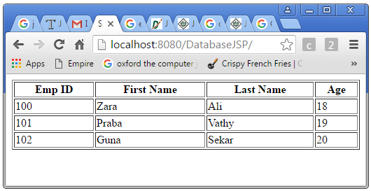
Output Snapshots

